Slide 1
Time series forecasting
PACF and ACF graphs
Auto Regressive Model
Moving Average
ARMA
Stationarity
ARIMA Forecasting

Slide 2
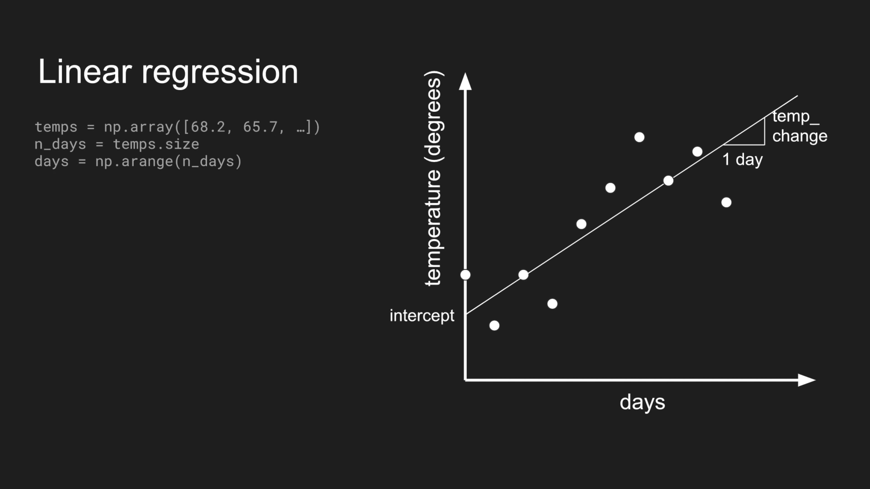

Slide 3
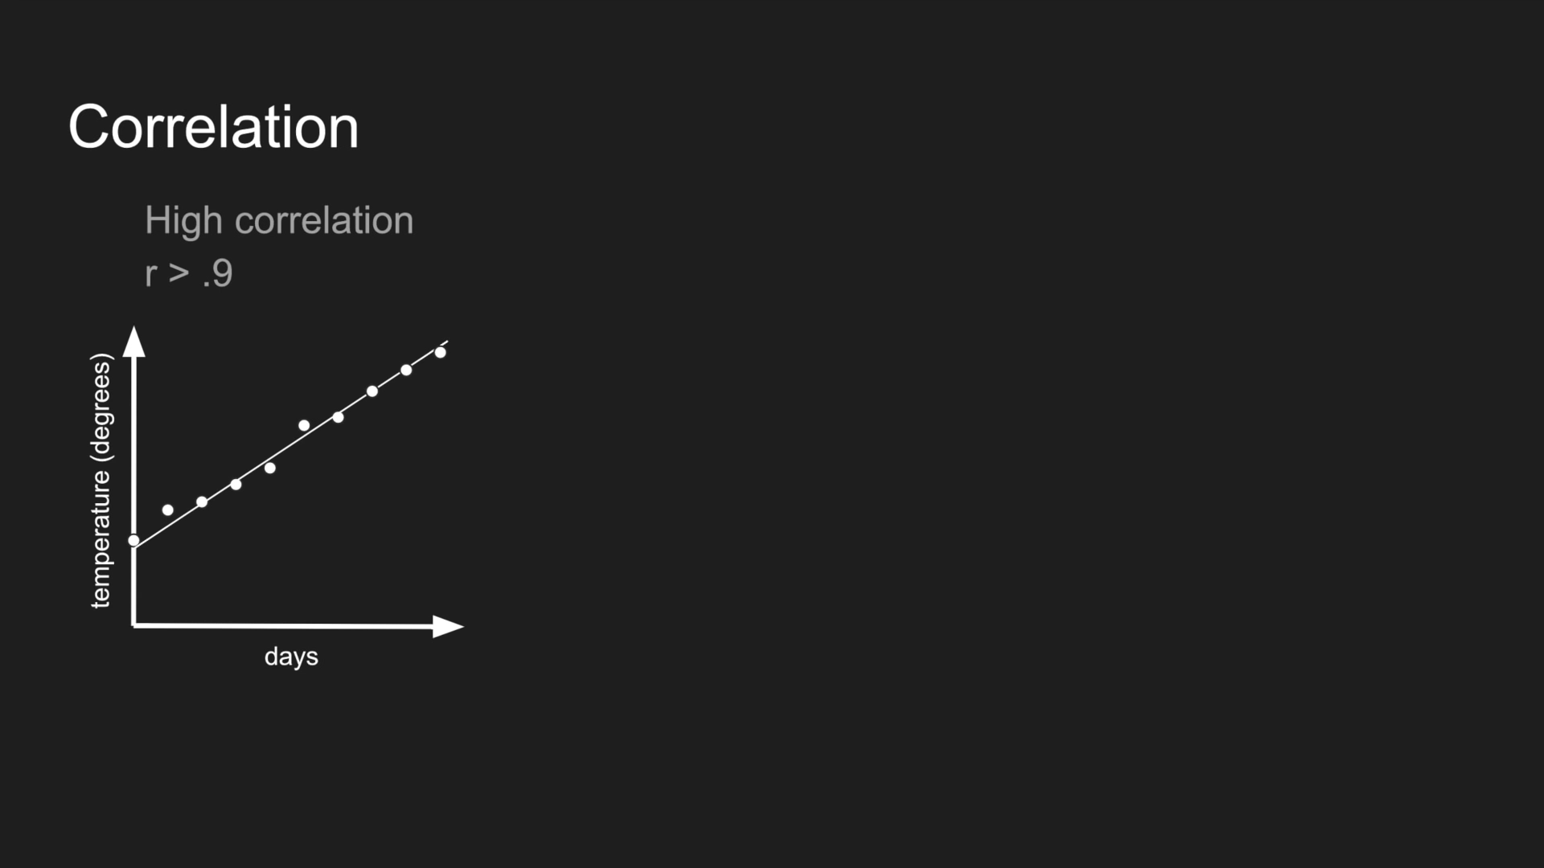

Slide 4
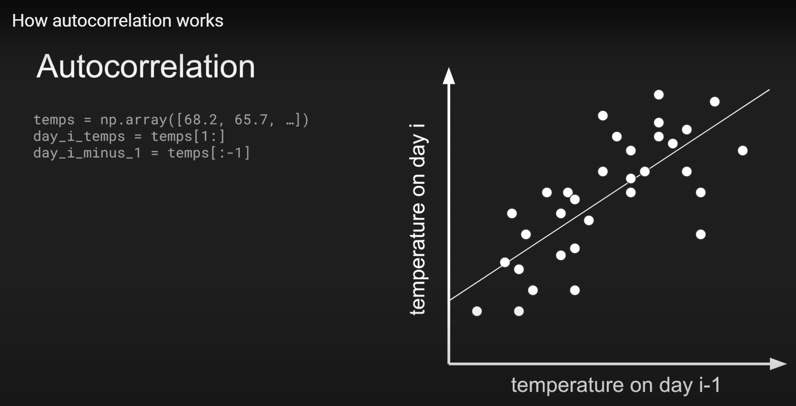

Slide 5
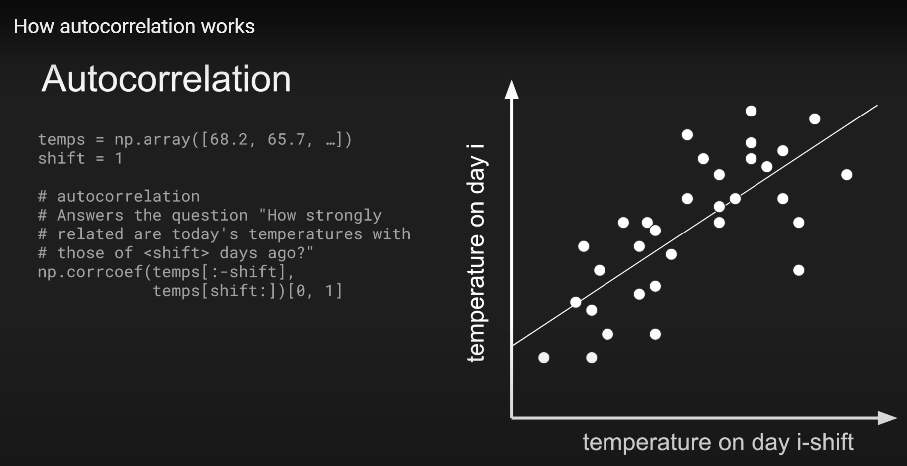

Slide 6
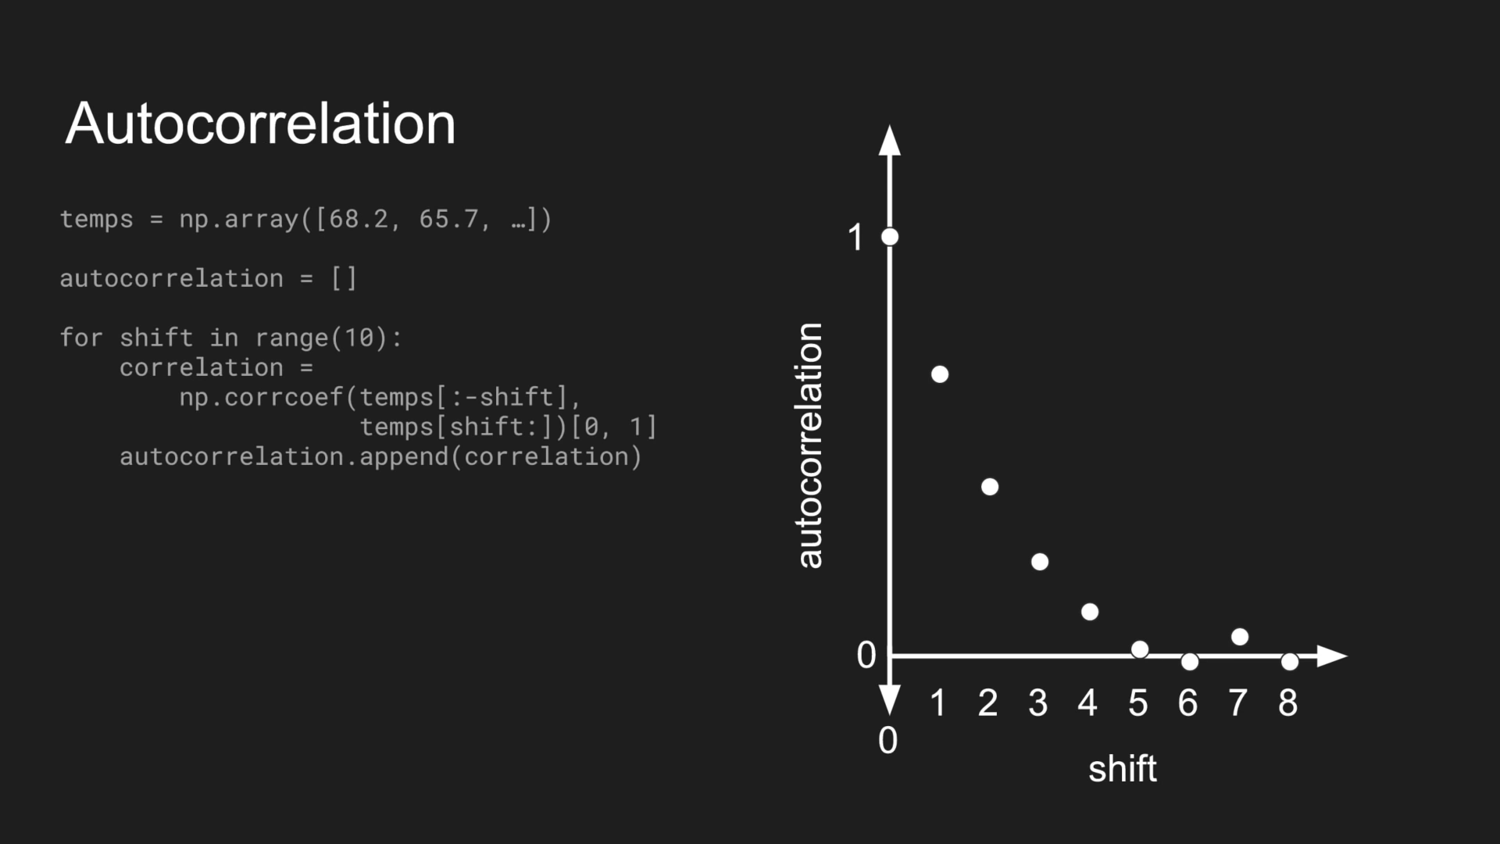

Slide 7
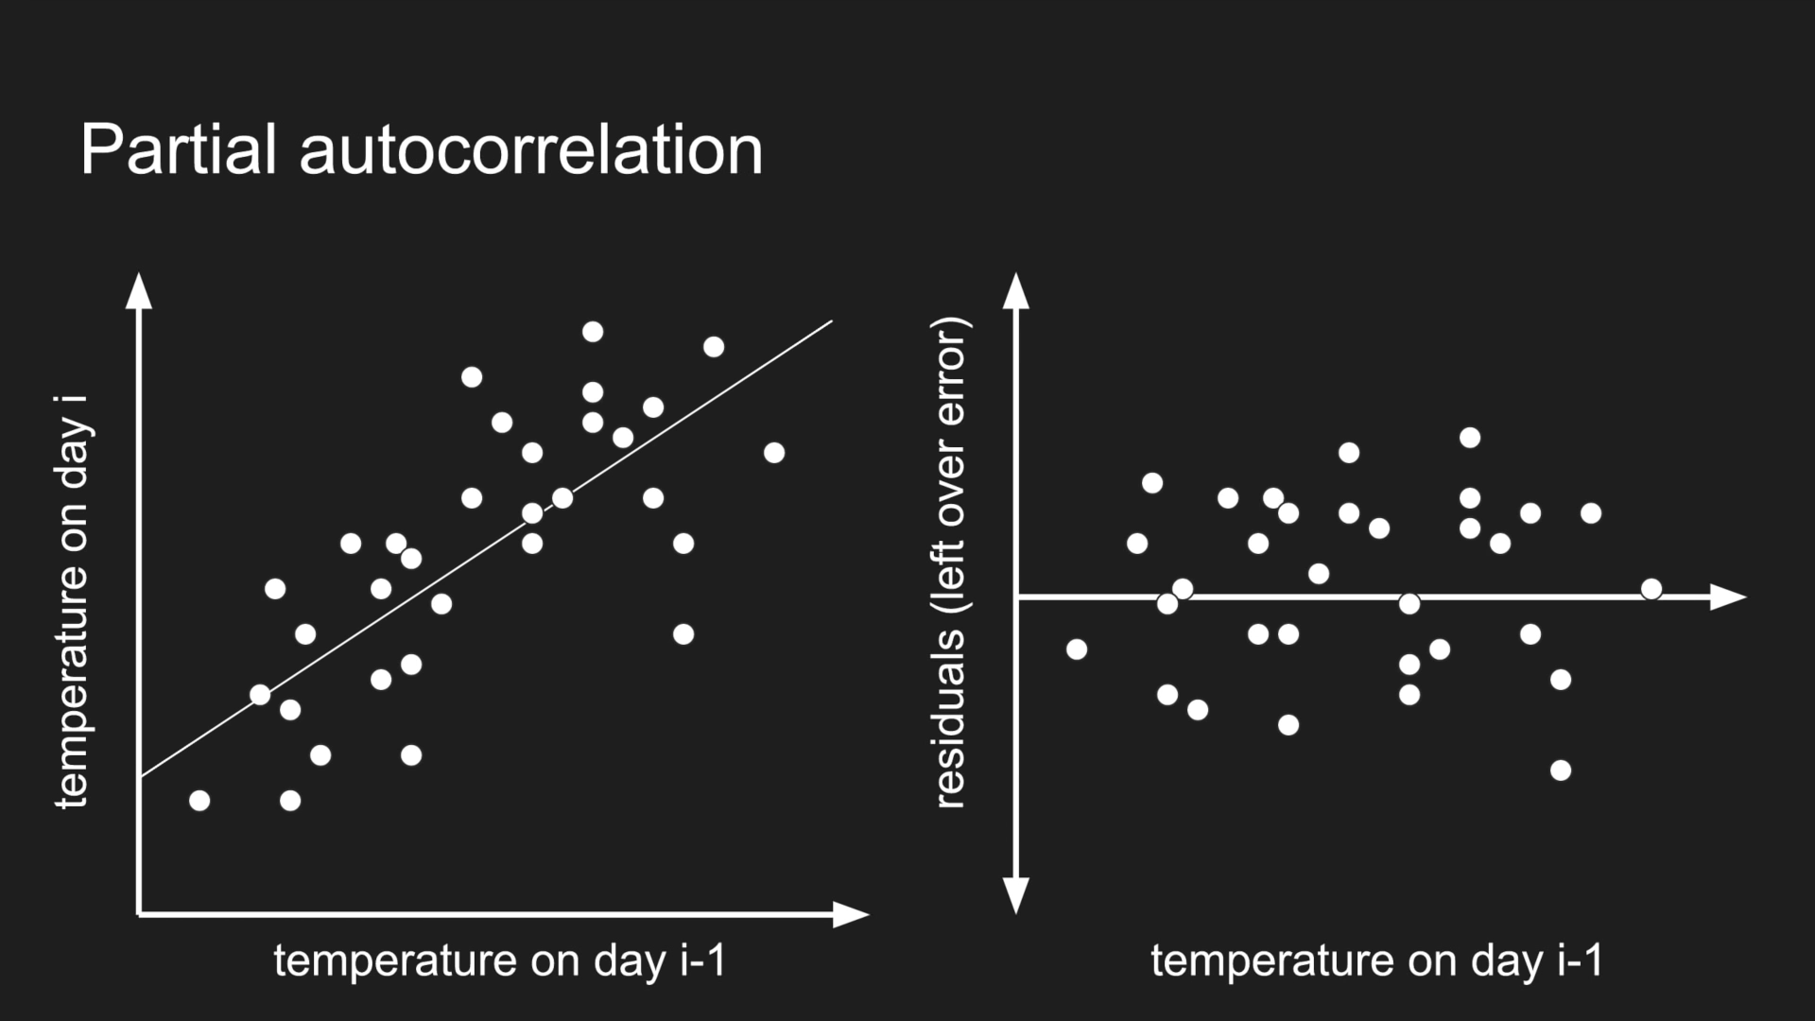

Slide 8
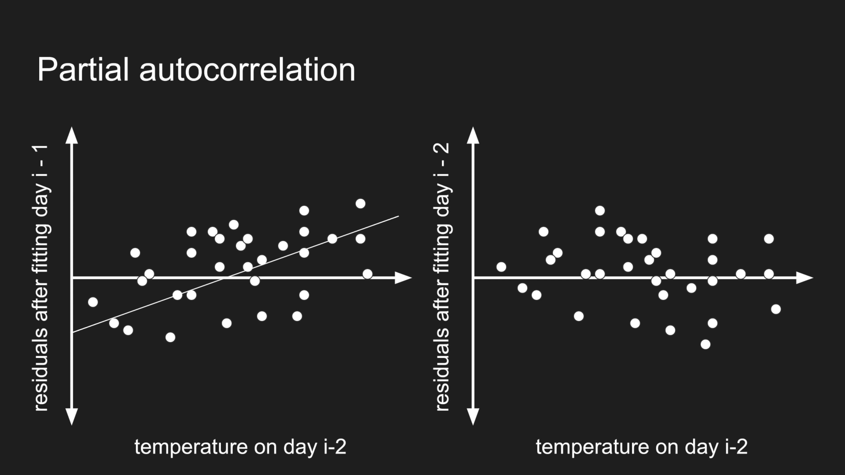

Slide 9
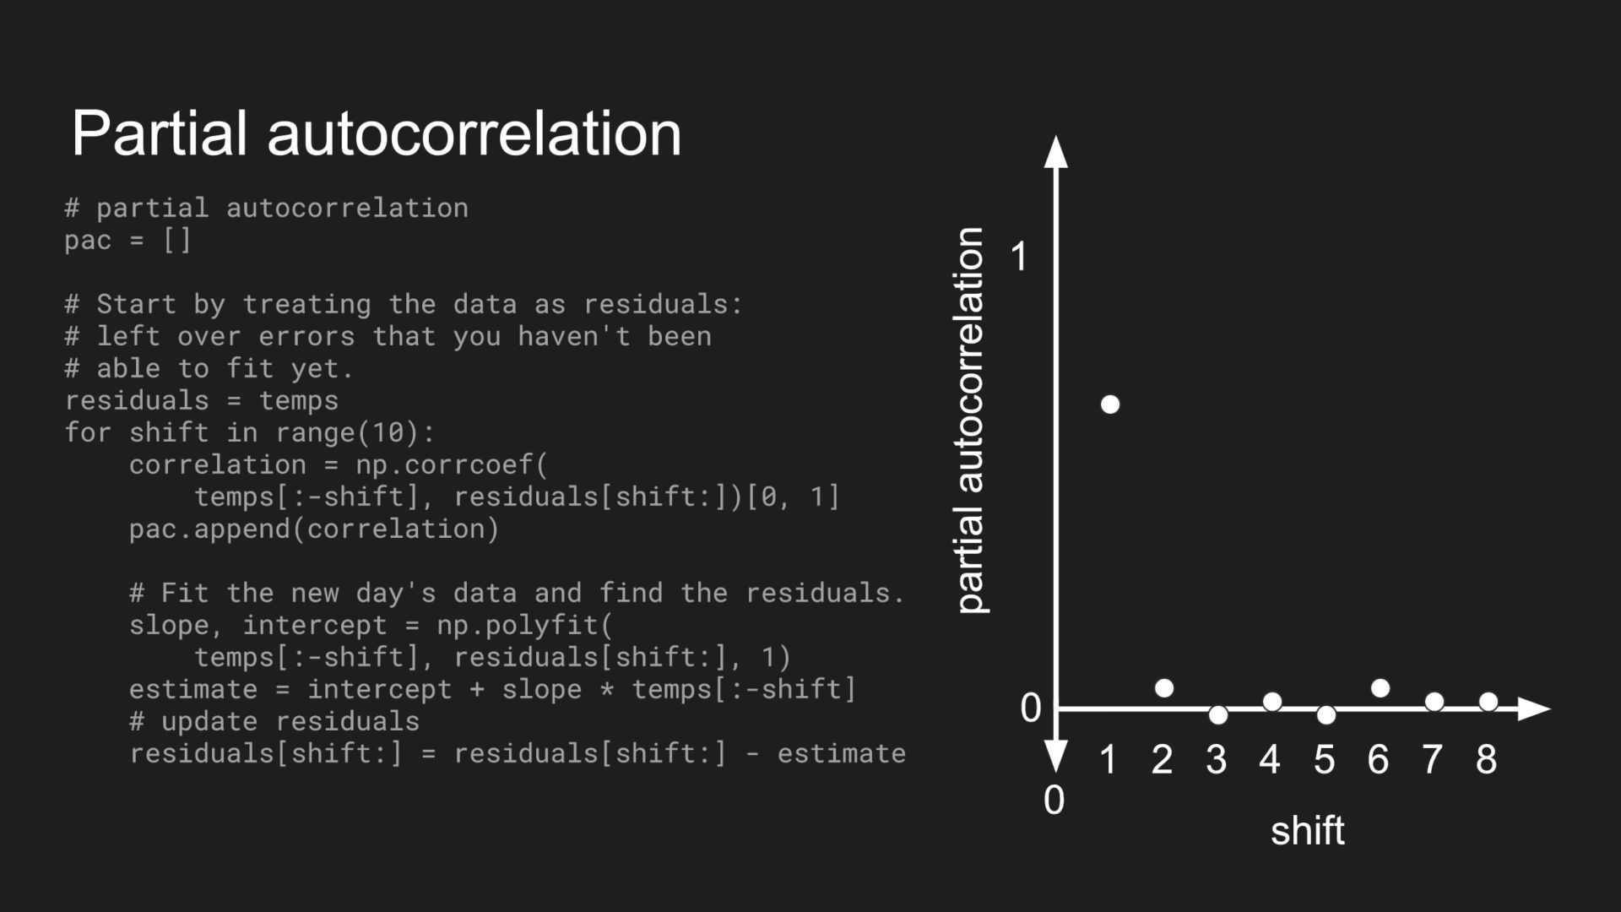

Slide 10
Time series
Any set of observations which is time dependent or we can say time is one of important variable on which the data patterns varies is called time series.
Many case is real world scenarios possesses these kind of time dependent observation
Example – Stock Price, Currency Change, Climate etc.

Slide 11
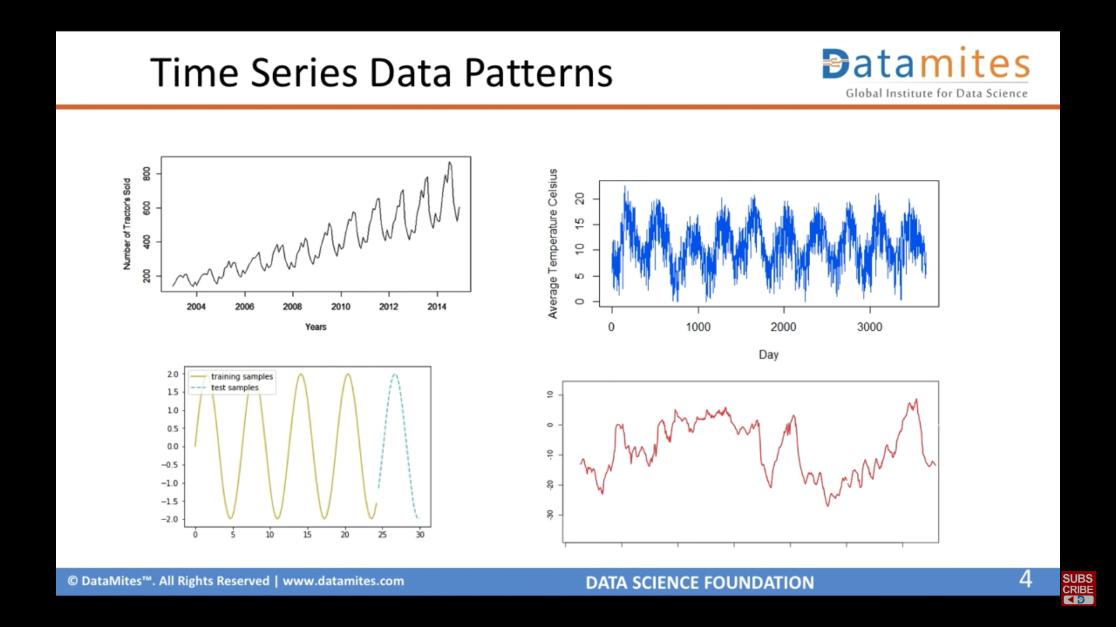

Slide 12
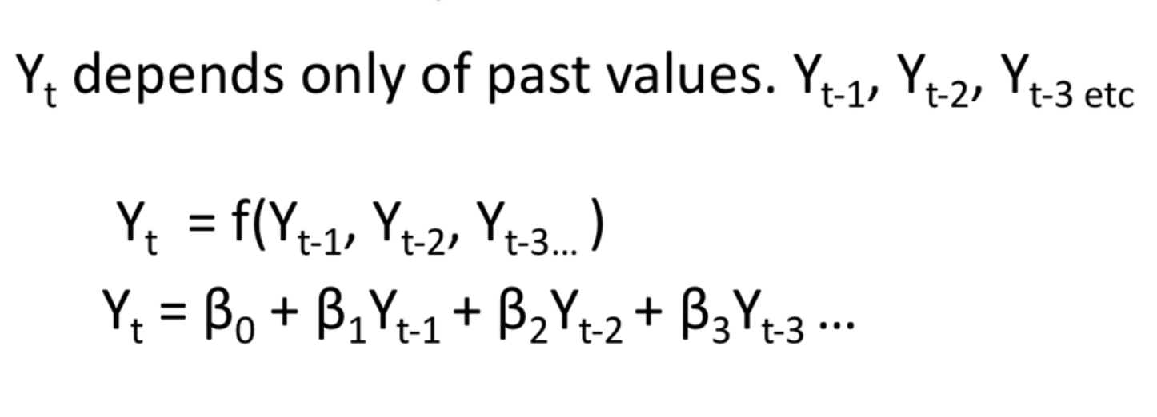
AUTO REGRESSIVE MODEL

Slide 13
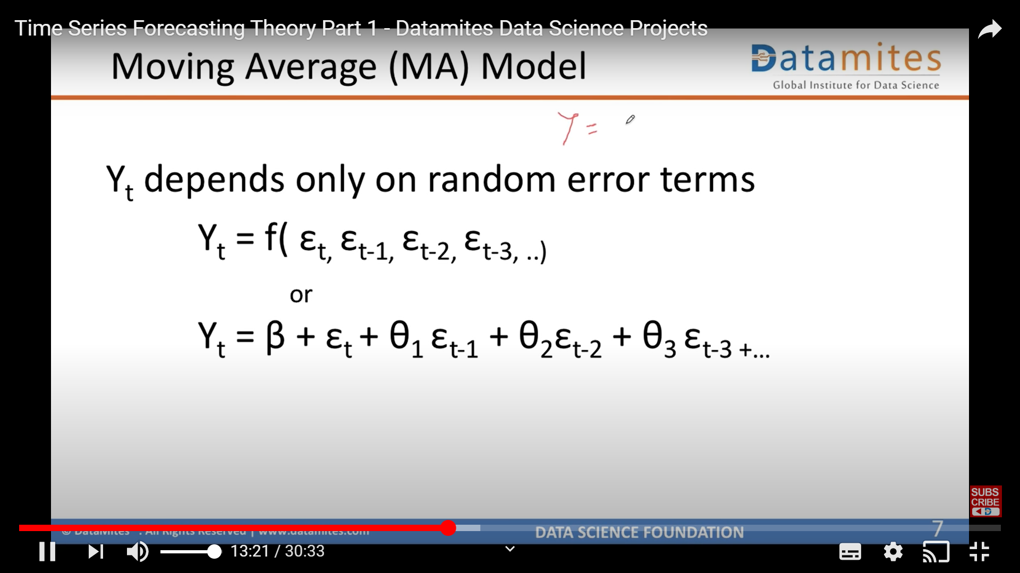
MOVING AVERAGES

Slide 14
Stationary time series
Stationarity means that the statistical properties of a time series (or rather the process generating it) do not change over time.
Mean remains constant over time.
Standard Deviation remains constant over time.
If the test statistic is greater than the critical value, we reject the null hypothesis (series is not stationary). If the test statistic is less than the critical value, if fail to reject the null hypothesis (series is stationary)

